Slide 1


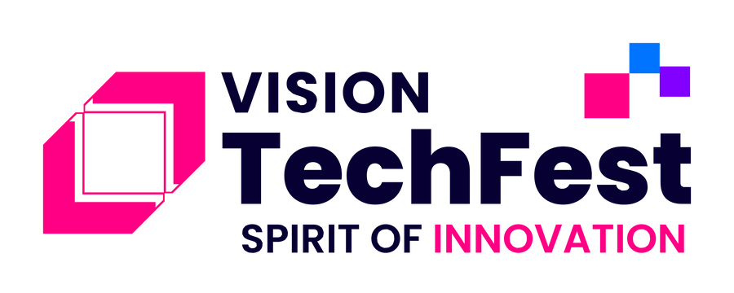

2024 FINAL PRESENTATIONS
The Smart Traveler’s Secret
AI-Based Travel Itinerary Maker
Team: Travel Genie
Notes:
1.7.2013
‹#›

Slide 2




Agenda
Introduction
Brief overview of the AI-Travel-Planner and its purpose.
Problem Statement
Challenges faced by travelers in planning personalized trips.
Supporting Data
Trends and the demand for automated itinerary planning.
Approach & Solution Architecture
Technical architecture of the AI-Travel-Planner.
Impact
Benefits of the solution and its impact on users.
Demo & Conclusion
Screenshots and live demo and discussing future upgrades.

Slide 3
Problem Statement Travel planning can be challenging, requiring time and effort to select destinations, stay , and activities.
Solution offered Personalized travel itinerary maker by analyzing your preferences, duration, and specific needs.
AI-Driven personalised plan
It provides curated recommendations for destinations, activities, stay, and transportation.
Seamless Booking Integration Delivers insights for any destination, from popular landmarks to hidden gems off the beaten path with booking
Time-Consuming Research
Lack of Personalized Recommendations
Overwhelming Amount of Information

Slide 4
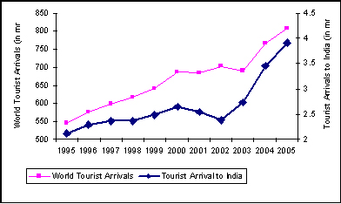
Supporting Data
Annual Growth Rate: The Indian travel and tourism industry is projected to grow at an annual rate of 7.1%​. This reflects an increasing trend as the industry rebounds post-pandemic.
Tourism GDP Contribution: In 2022, the travel and tourism sector contributed approximately $199.6 billion to India’s GDP, and this is expected to rise to $512 billion by 2028​.
Foreign Tourist Arrivals: The number of foreign tourist arrivals (FTAs) has been on the rise, with 9.24 million arrivals recorded in 2023, compared to 6.44 million in 2022. As of May 2024, FTAs increased further, indicating strong recovery​.
Visitor Spending Growth: Domestic visitor spending rose by 20.4% in 2022, while international visitor spending increased by 81.9% during the same period​.
References: INDIA BRAND EQUITY FOUNDATION, MCKINSEY & COMPANY, ECON DATA HUB
10%
5%
30cr
India Contributed $8.9 trillion to the global economy in 2019,
In 2019, there were 1.4 billion international tourist arrivals
Approximately $400,000 is spent on travel bookings worldwide

Slide 5
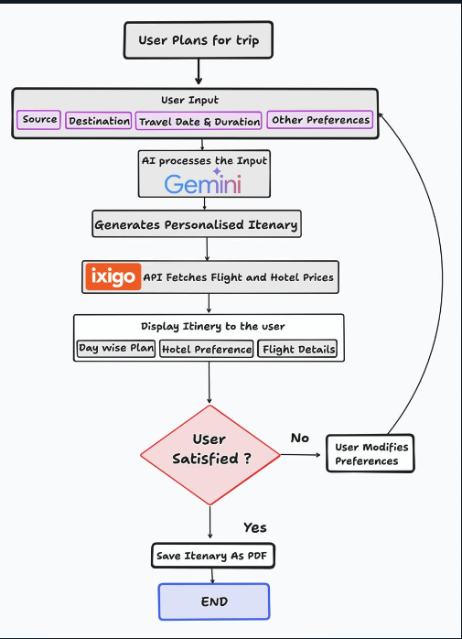
Solution Architecture

Slide 6
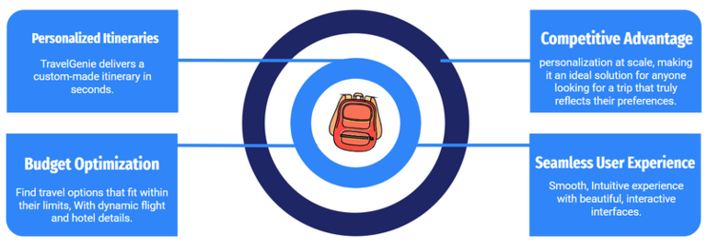




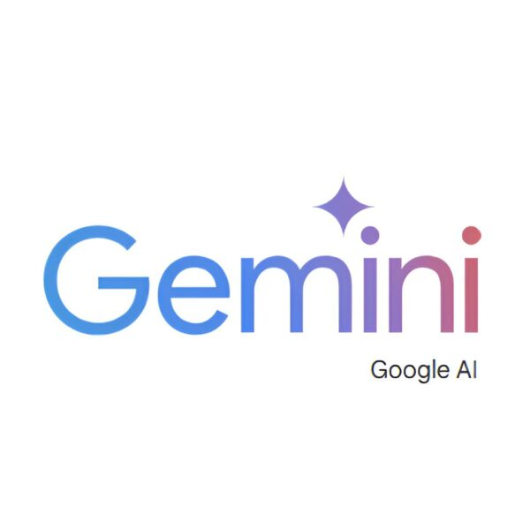

Approach & Tech Stack
User-Centric Design
Data-Driven Insights
Dynamic Itinerary Generation
RealTime Updates
User Feedback Loop
Seamless User Experience
3

Slide 7
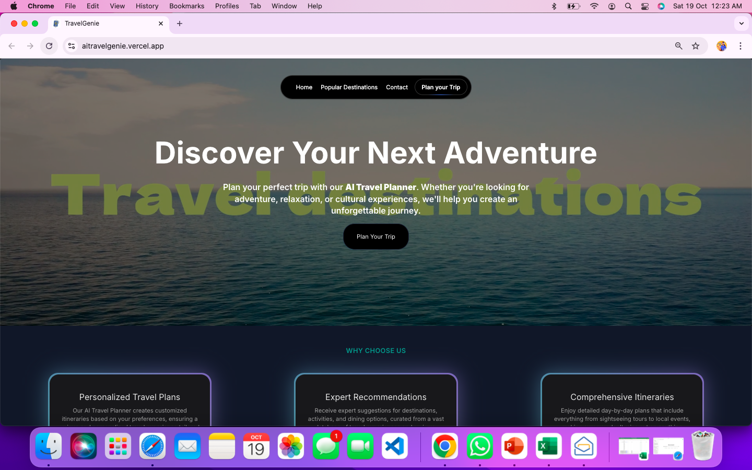
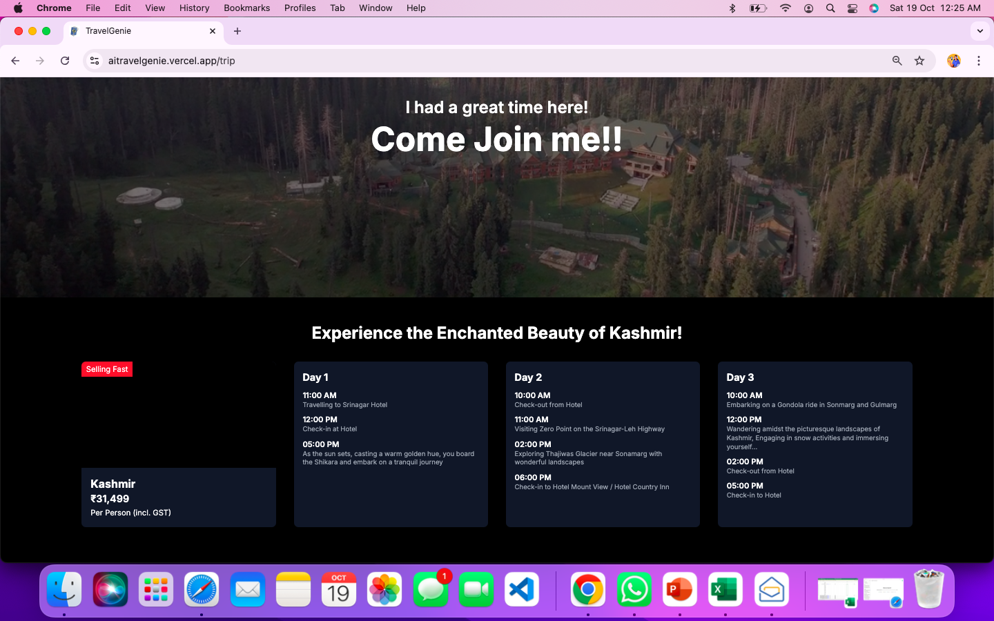
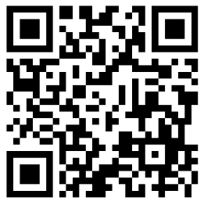
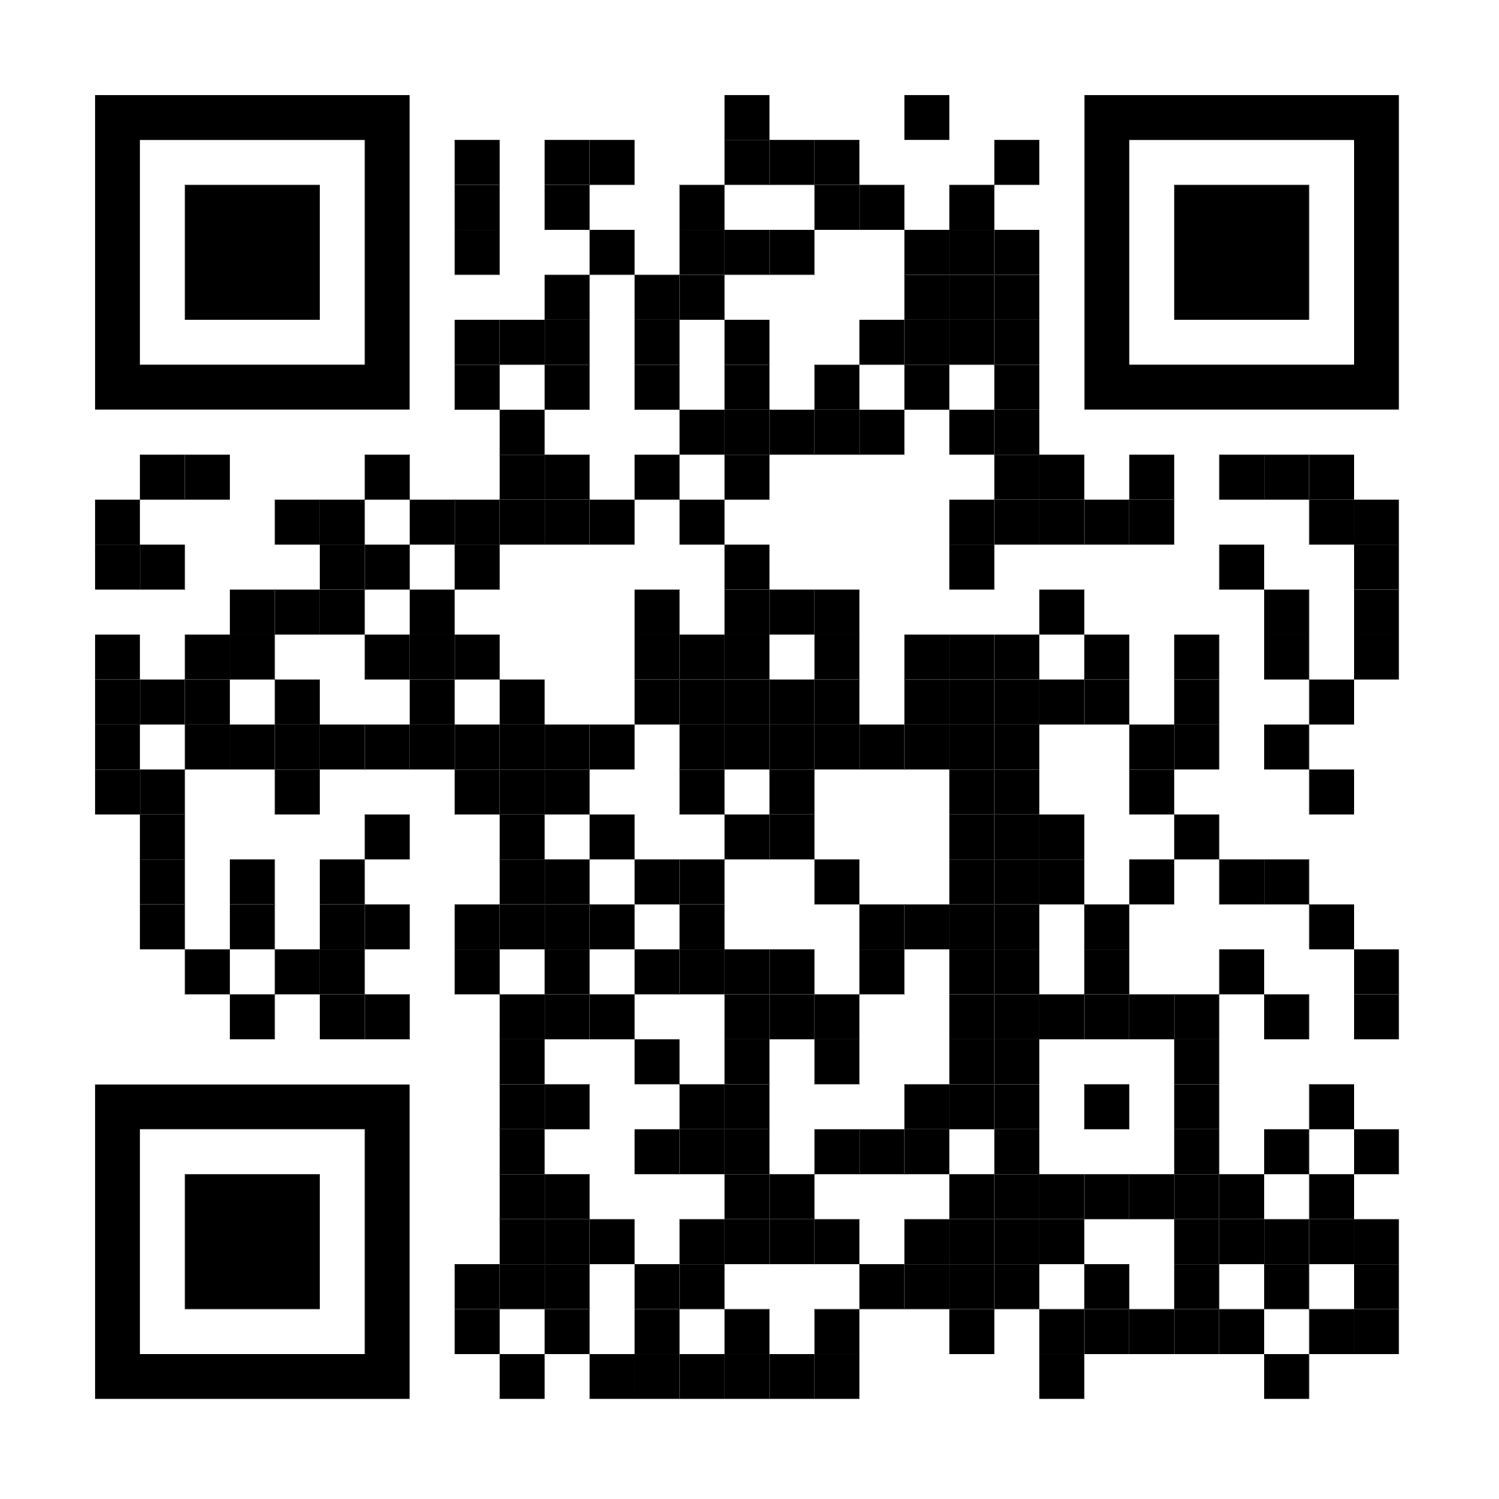
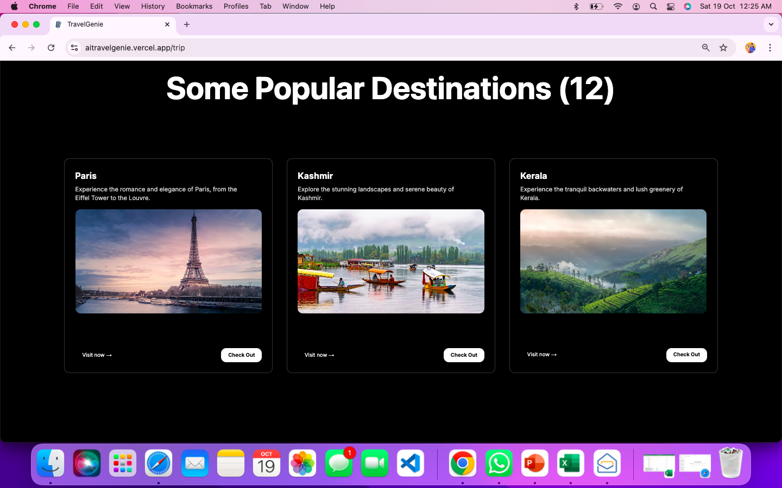
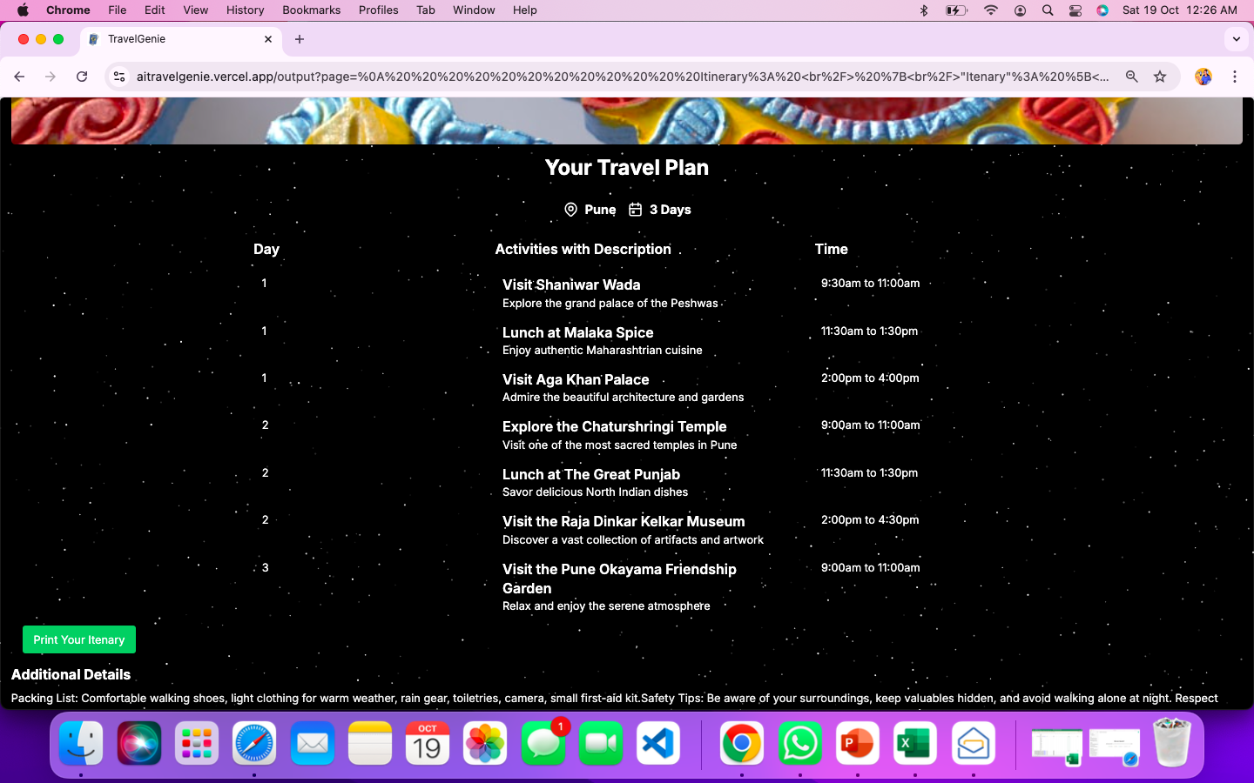
Screenshots Live Demo
Scan Me!!
Web View
Android App
Link: Click here
Demo Video: Youtube or Loom

Slide 8
Impacts
Enhanced Travel Experience
Economic Benefits
Sustainable Travel
Feedback and Improvement with Market Competitiveness
Personalization, TimeSaving
Boost to Local Economies, Job Creation
Data-Driven Recommendations, Environmental Awareness
Continuous Improvement, Positioning in the Travel Industry
Users receive tailored itineraries that reflect their unique preferences, leading to greater satisfaction and memorable experiences.
Automated planning reduces the time spent researching and organizing trips, allowing users to focus on enjoying their travels.
Increased tourism contributes to local businesses, including restaurants, attractions, and hotels, enhancing their revenue streams.
Growth in the tourism sector can lead to job creation in various areas, from hospitality to transportation.
The use of real-time data can promote off-peak travel and lesser-known destinations, helping to distribute tourist footfall and reduce congestion.
Encouraging travelers to make informed choices can foster responsible tourism practices.
The feedback loop allows the system to evolve, improving recommendations and user satisfaction over time.
By leveraging AI and data analytics, the project can stand out in the competitive travel market, attracting tech-savvy travelers.

Slide 9
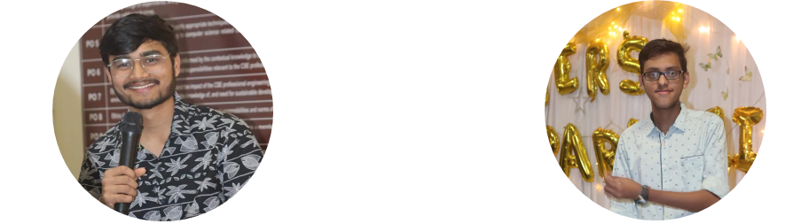
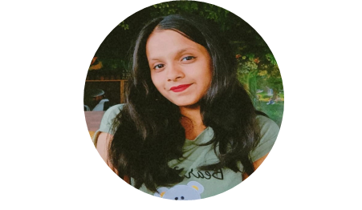
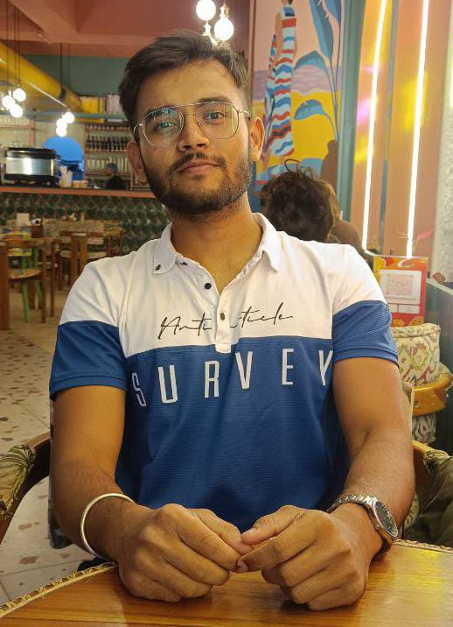
Conclusion
Transforming Travel Planning:
Our AI-Travel-Planner harnesses the power of artificial intelligence to create personalized and efficient itineraries, addressing the common pain points faced by travelers.
By providing real-time data, user-centric features, and a seamless experience, we aim to revolutionize how people plan and enjoy their journeys. Future Enhancements
We envision expanding our platform with additional features, including more integrations, enhanced user feedback mechanisms, and support for diverse travel needs.
Our goal is to continually improve and adapt to the evolving preferences of travelers, ensuring they have memorable experiences.
Thank you for letting up present our idea at VisioNet TechThon 2024. Presented by
Vidhan Mehta
AIML
The Oxford College of Engineering
Sumith Sigtia
AIML The Oxford College
Of engineering
Swathi S
AIML The Oxford College
Of engineering
Pankaj Kumar
CSE The Oxford College
Of engineering

